Slide 1
CS 35L Software Construction Lab Week 5 - C Programming

Slide 2
Basic Data Types
int
Holds integer numbers
Usually 4 bytes
float
Holds floating point numbers
Usually 4 bytes
double
Holds higher-precision floating point numbers
Usually 8 bytes (double the size of a float)
char
Holds a byte of data, characters
Char my_string[100]
void

Slide 3
A simple C Program
#include <stdio.h>
int main() {
printf("Hello World\n");
getchar();
return 0;
}

Slide 4
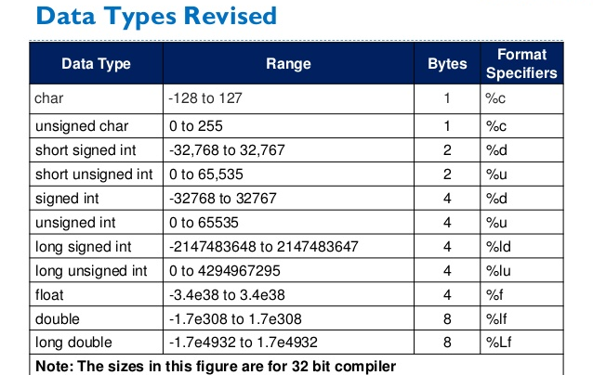
Format Specifiers in C
Defines the type of data to be printed on standard output - printf(“%d”, 4); //%d is integer
Byte size dependent on compiler
Notes:
f you are using GCC and you are not using compilation flags that remove compiler specific extensions, then sizeof(void) is 1. GCC has a nonstandard extensionthat does that.
In general, void is a incomplete type, and you cannot use sizeof for incomplete types.

Slide 5
Pointers
Variables that store memory addresses
Declaration
<variable_type> *<name>;
int *ptr; //declare ptr as a pointer to int
int var = 77; // define an int variable
ptr = &var; // let ptr point to the variable var

Slide 6
Dereferencing Pointers
Accessing the value that the pointer points to
Example:
double x, *ptr;
ptr = &x; // let ptr point to x
*ptr = 7.8; // assign the value 7.8 to x

Slide 7
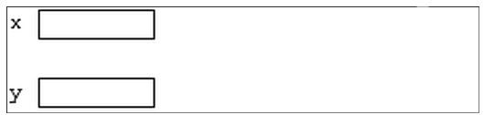
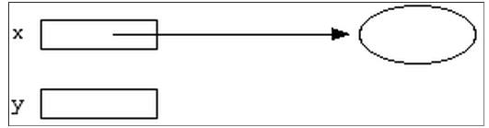
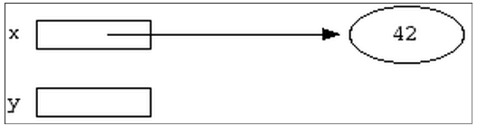
Pointer Example
int *x;
int *y;
int var; x = &var;
*x = 42;

Slide 8
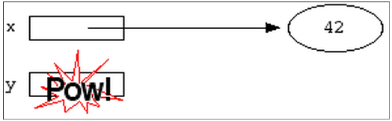
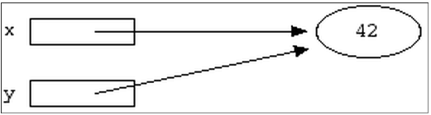
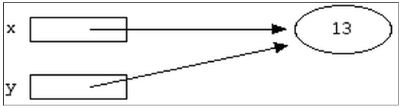
Pointer Example
*y = 13;
y = x;
*x = 13; or
*y = 13;
Notes:
Pointer arithmetic

Slide 9
Try it out! – print and see results
#include <stdio.h>
int main() {
int *x; int var;
x=&var;
*x=42;
// printf("%d\n",x);
int *y;
*y=13;
var=22;
y=x;
// printf("%d",*x);
printf("%d",*y);
return 0;}

Slide 10
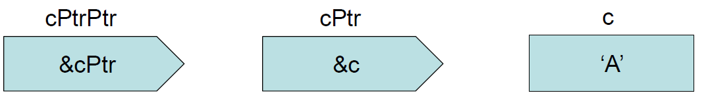
Pointers to Pointers
char c = ‘A’ char *cPtr = &c char **cPtrPtr = &cPtr
Notes:
Char** - Array of char*

Slide 11
Loops
for(int i=0;i<10;i++){
}
int i=0;
while(i<10){
i++; }

Slide 12
Functions
Function Name
Return Type
Arguments/Parameters
Function Body
int func(int a){
//whatever
return 0;
}

Slide 13
Parameter Passing
Pass by value
The data associated with the actual parameter is copied into a separate storage location assigned to the formal parameter.
Any modifications to the formal parameter variable inside the called function or method affect only this separate storage location and will therefore not be reflected in the actual parameter in the calling environment
int add(int a, int b) {
return a+b;
}
void main() {
int x=4,y=8;
int z = add(x,y);
printf(“%d”,z);
}

Slide 14
Parameter Passing...
Pass by reference
The formal parameter receives a pointer to the actual data in the calling environment. Any changes to the formal parameter are reflected in the actual parameter in the calling environment.
void swap(int *a, int *b) {
int tmp = *a;
*a = *b;
*b = tmp;
}
void main() {
int a = 1;
int b = 2;
printf("before swap a = %d\n", a);
printf("before swap b = %d\n", b);
swap(&a, &b);
printf("after swap a = %d\n", a);
printf("after swap b = %d\n", b); }

Slide 15
Task 1
Create a function s.t. it takes three numbers ‘a’, ‘b’ and ‘c’ as arguments, computes a^{b} and store the results in ‘c’. It should not return any value. Call this function from main() and print the answer in main().
Hint: argument c as pointer (passed as reference)
Hint: you may wanna see the pow function [check the return type and library] (or compute the exponent yourself <- better)

Slide 16
Task 1 solution
#include <stdio.h>
#include <math.h> //library import
void exponent(int a, int b, double *c){
*c=pow(a,b); //pow returns a pointer
}
int main(void) {
int a=2;
int b=2;
double z;
exponent(a,b,&z);
printf("%f", z);
return 0;
}

Slide 17
Output?
# include <stdio.h> void fun(int *ptr) { *ptr = 30; } int main() { int y = 20; fun(&y); printf("%d", y); return 0; }

Slide 18
Output?
#include <stdio.h> int main() { int *ptr; int x; ptr = &x; *ptr = 0; printf(" x = %d\n", x); printf(" *ptr = %d\n", *ptr); *ptr += 5; printf(" x = %d\n", x); printf(" *ptr = %d\n", *ptr); (*ptr)++; printf(" x = %d\n", x); printf(" *ptr = %d\n", *ptr); return 0; }

Slide 19
Answer?
(A) x = 0 *ptr = 0 x = 5 *ptr = 5 x = 6 *ptr = 6 (B) x = garbage value *ptr = 0 x = garbage value *ptr = 5 x = garbage value *ptr = 6
(C) x = 0 *ptr = 0 x = 5 *ptr = 5 x = garbage value *ptr = garbage value (D) x = 0 *ptr = 0 x = 0 *ptr = 0 x = 0 *ptr = 0

Slide 20
Explanation: (A) See the comments below for explanation.
int *ptr; /* Note: the use of * here is not for dereferencing,
it is for data type int */
int x;
ptr = &x; /* ptr now points to x (or ptr is equal to address of x) */
*ptr = 0; /* set value ate ptr to 0 or set x to zero */
printf(" x = %d\n", x); /* prints x = 0 */
printf(" *ptr = %d\n", *ptr); /* prints *ptr = 0 */
*ptr += 5; /* increment the value at ptr by 5 */
printf(" x = %d\n", x); /* prints x = 5 */
printf(" *ptr = %d\n", *ptr); /* prints *ptr = 5 */
(*ptr)++; /* increment the value at ptr by 1 */
printf(" x = %d\n", x); /* prints x = 6 */
printf(" *ptr = %d\n", *ptr); /* prints *ptr = 6 */

Slide 21
Output?
#include <stdio.h> int main() { int arri[] = {1, 2 ,3}; int *ptri = arri; char arrc[] = {1, 2 ,3}; char *ptrc = arrc; printf("sizeof arri[] = %d ", sizeof(arri)); printf("sizeof ptri = %d ", sizeof(ptri)); printf("sizeof arrc[] = %d ", sizeof(arrc)); printf("sizeof ptrc = %d ", sizeof(ptrc)); return 0; }

Slide 22
sizeof arri[] = 12 sizeof ptri = 4/8 //depending on your machine sizeof arrc[] = 3 sizeof ptrc = 4/8 Explanation: Size of an array is number of elements multiplied by the type of element, that is why we get sizeof arri as 12 and sizeof arrc as 3. Size of a pointer is fixed for a compiler. All pointer types take same number of bytes for a compiler. That is why we get 4/8 (64 bit machine) for both ptri and ptrc.

Slide 23
Pointers to Functions
Also known as: function pointers or functors
Goal: write a sorting function
Has to work for ascending and descending sorting order
How?
Write multiple functions
Provide a flag as an argument to the function
Use function pointers!!

Slide 24
Pointers to Functions
User can pass in a function to the sort function
Declaration
double (*func_ptr) (double, double);
func_ptr = pow; // func_ptr points to pow()
Usage
// Call the function referenced by func_ptr
double result = (*func_ptr)( 1.5, 2.0 );

Slide 25
Function Pointers
Used to call functions not by function-name but by a pointer to that function!
#include <stdio.h>
void fun(int a)
{
printf("Value of a is %d\n", a);
}
int main()
{
void (*fun_ptr)(int) = &fun;
(*fun_ptr)(10);
return 0;
}

Slide 26
qsort Example
#include <stdio.h>
#include <stdlib.h>
int compare (const void * a, const void * b)
{
return ( *(int*)a - *(int*)b ); // typecasting a and b as int * and then deferencing
}
int main ()
{
int values[] = { 40, 10, 100, 90, 20, 25 };
qsort (values, 6, sizeof(int), compare);
int n;
for (n = 0; n < 6; n++)
printf ("%d ",values[n]);
return 0;
}

Slide 27
Structs
No classes in C
Used to package related data (variables of different types) together
Single name is convenient
struct Student { typedef struct{
char name[64]; char name[64];
char UID[10]; char UID[10];
int age; int age;
int year; int year;
}; } Student;
struct Student s; Student s;

Slide 28
typedef declarations
Easy way to use types with complex names
typedef struct { double x, y; } Point_t;
typedef struct
{
Point_t top_left;
Point_t bottom_right;
} Rectangle_t;

Slide 29
Dynamic Memory
Memory that is allocated at runtime
Allocated on the heap
void *malloc (size_t size);
Allocates size bytes and returns a pointer to the allocated memory
void *realloc (void *ptr, size_t size);
Changes the size of the memory block pointed to by ptr to size bytes
void free (void *ptr);
Frees the block of memory pointed to by ptr

Slide 30
Reading/Writing Characters
int getchar();
Returns the next character from stdin. EOF when input ends or error encountered.
int putchar(int character);
Writes a character to the current position in stdout
Notes:
Feof()

Slide 31
Formatted I/O
int fprintf(FILE * fp, const char * format, …);
int fscanf(FILE * fp, const char * format, …);
FILE *fp can be either:
A file pointer
stdin, stdout, or stderr
The format string
int score = 120; char player[] = “Mary”;
fp = fopen(“file.txt”, “w+”)
fprintf(fp, “%s has %d points.\n”, player, score);

